Slide 1
British Airline Customer Review Analysis

Slide 2
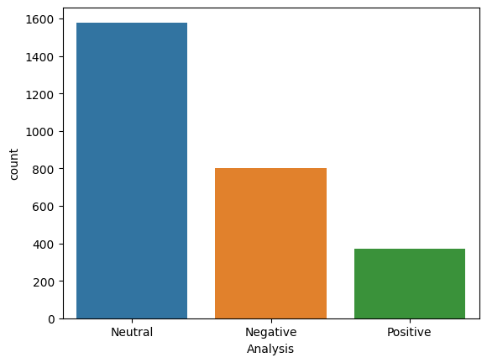

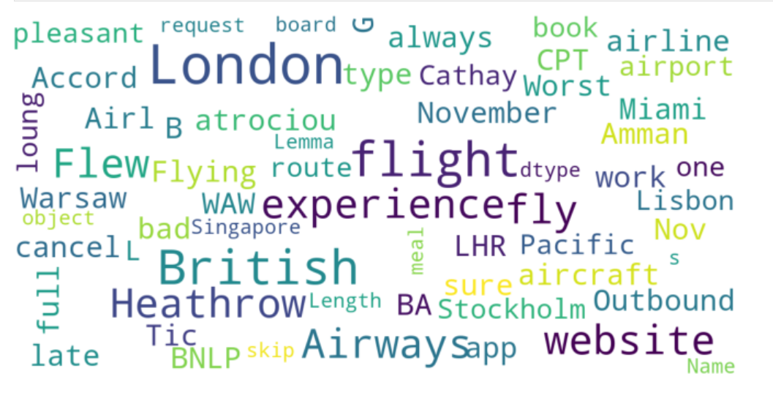
RESULTS
The key topics within the reviews include “service”, “seat”, “crew” and “staff”, showing that people are actively talking about their experience and staff.
Sentiment Out of 2500+ reviews, 371 were positive, 802 were negative and 1579 were neutral.
Source of Data: https://www.airlinequality.com/airline-reviews/british-airways/page/2
Frequently Used Words:

